Slide 1
RA vs OA
 | Rheumatoid Arthritis | Osteoarthritis
Pathophysiology | Immune complex in cartilage & synovium Initiation of inflammatory process: RF and CRP | Wear and tear
Mediators | Macrophages → secrete cytokines T cell → secrete cytokine TNF-α B cell → secrete Rheumatoid Factors Rheumatoid factor → autoantibody in 75% RA pts | Old
Tx | Autoimmune response | symptoms
Joints | Small joints (hands) | Weight bearing joints Hips, knees, spine
S/S | Swelling, redness, stiffness Symmetrical S/S Anemia: Nomocytic: normal cell size = measure MCV Nono chromic: same color | “ “ Not symmetrical S/S
Notes:
CRP = C reactive protein
List drug ---- list MOA

Slide 2
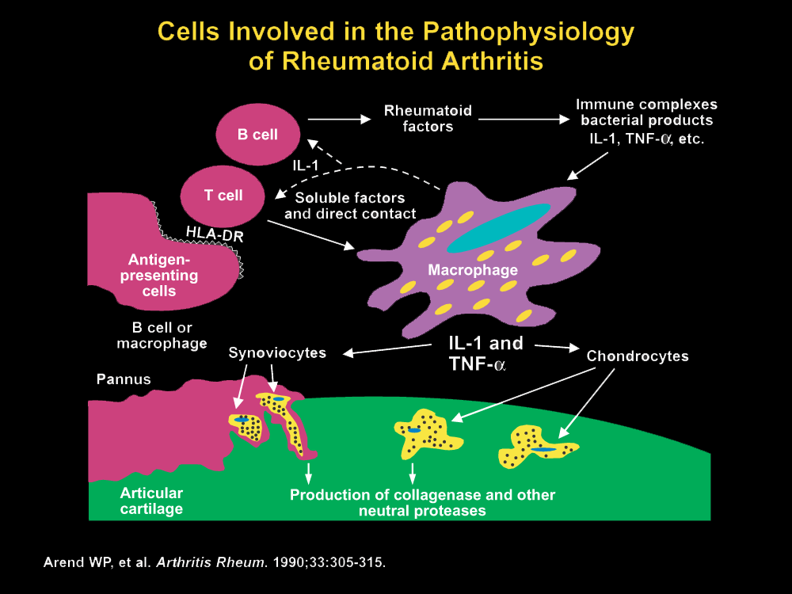
Notes:
B cells release Rheumatoid Factors

Slide 3
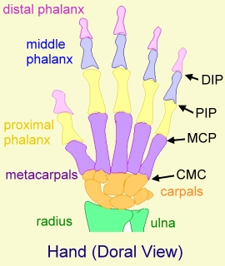
Must have 4 of 7 to be DIAGNOSED with RA
1. Morning stiffness in and around joints lasting at least 1 hour before maximal improvement
2. Soft tissue swelling (arthritis) of three or more joint areas observed by a physician
3. Swelling (arthritis) of the PIP, MCP or wrist joints.
4. Symmetric arthritis
5. Rheumatoid nodules
6. Positive test for RF
7. Radiographic erosions or periarticular osteopenia in hand or wrist joints
5 of 6 for 2 months to be CURED of RA:
No morning stiffness
No fatigue
No joint pain
No joint pain in motion
No soft tissue swelling
6. Females: ESR < 30 mm/hr
Males : ESR < 20 mm/hr
Notes:
Know diagnosis
MCP: Metacarpophalangeal joint
PIP: proximal interphalangeal joint

Slide 4
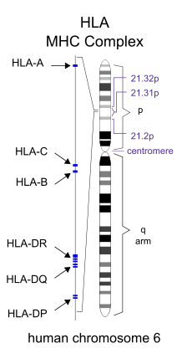
Factors that can cause RA
Genetics | Found in:
HLA-DR1 | Italians, Israeli Jewish Hispanics
HLA-DR4 | North Europeans and Americans
HLA-DR14 | Yakima Indians
Environment | Found in:
Infection | Bacteria- Mycobacteria, Mycoplasma Virus- Retrovirus, herpes, Epstein-Barr virus, Rubella
Factors predicting poor prognosis:
male, age >50,
poor functional capacity,
positive RF, presence of nodules,
HLA-DR4 haplotype;
> 20 joints involved

Slide 5
Phase 1 Tx Algorithm
Initial Diagnosis of RA
Drug: DMARD | Use next if:
Methotrexate + Folic Acid | Pregnant Chronic Liver Disease Blood Dyscrasias
Leflunomide | Pregnant
Sulfasalazine (txs mild) | Moderate/Severe RA
IM Gold
+/-
NSAIDS
Follow up in 3 – 6 months.
Cured of RA?
Yes
No
Continue Tx
Go to Phase 2
Notes:
DMARD: effect is slow
NSAID helps with pain quickly

Slide 6
Phase 2 Tx Algorithm
Any Efficacy from Phase 1?
No Efficacy:
Add TNF-Inhibitor
Efficacy:
Add second DMARD from Phase 1
Follow up in 3 – 6 months
If not cured, then go to phase 3
Follow up in 3 – 6 months
Not not cured, then add TNF (phase 3)
Phase 3 Tx Algorithm
Change to another
TNF-Inhibitor
or
Biological Tx | + | DMARD
Rituximab | + | DMARD
Abatacept | + | DMARD
Tocilizumab | +/-

Slide 7
Algorithm (again)

Slide 8
Drugs: Phase 1 Tx
NSAIDS
DMARDS
Bridge DMARDS with glucocorticoids

Slide 9
NSAIDS and COX-2 Inhibitor
 | NSAIDS | COX-2
Drugs | Ibuprofen 400 mg q6h Nabumetone 1000 mg daily Diclofenac 50 mg TID | Celecoxib 200 mg daily
Anti-inflammatory effect | 1-2 weeks
Monitor | CBC at baseline yearly High risk pts: SCr weekly Diclofenac: LFT q8w | Pre-existing cardiac
Risk Factors | GI Risk factors > 60 y/o Take with corticosteroids Take with anticoagulants Renal risk factors CHF Diuretics cirrhosis | “ “
D-D | Lithium → increase Li levels Diuretics, ACE-I → renal
Notes:
b/c COX-2, FDA started black box warning: cardiac disease
Naproxen has least cardiac
Celecoxib in high doses has anti-angiogenesis activity → good for cancer
COX-1 blocks thomboxane → fluid blood → good on heart (Celebrex only blocks COX-2)

Slide 10
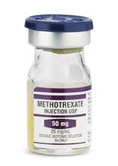
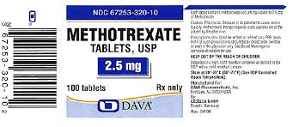
DMARD for phase 1: Disease-Modifying Antirheumatic Drug
Methotrexate
Use | Methotrexate is Gold Standard
MOA | Decrease T and B lymphocyte function Folic acid antagonist Interferes with purine biosynthesis
Dosing | PO or IM Weekly dosing + Folic acid 1 mg daily
Time to effect | 1 – 2 months
Monitor | Liver (cumulative toxicity), pulmonary
Notes:
Uses: autoimmune disease, cancer and ectopic pregnancy
ContraindicationsKnown hypersensitivity to methotrexate or any component of the formulation; breast-feeding
Additional contraindications for patients with psoriasis or rheumatoid arthritis: Pregnancy, alcoholism, alcoholic liver disease or other chronic liver disease, immunodeficiency syndrome (overt or laboratory evidence); pre-existing blood dyscrasias (eg, bone marrow hypoplasia, leukopenia, thrombocytopenia, significant anemia)

Slide 11
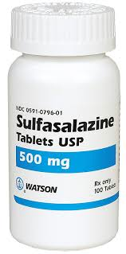
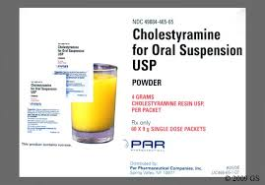
DMARD for phase 1: Disease-Modifying Antirheumatic Drug
Sulfasalazine
Use | Add on to methotrexate: Mild presentations
MOA | Unclear
Dosing | 1 gram PO BID
Time to effect | 1 – 3 months
Adverse effects | Photosensitivity (rash)
Leflunomide (Arava) | Not popular b/c of hepatotoxicity
MOA | Inhibits enzyme dihydroorate dehydrogenase used In pyrimidine synthesis
Dosing | 100 mg PO load for 3 days then 10 – 20 mg PO daily as maintenance
Time to effect | 1 – 3 months
Adverse effects | Liver → LFT monthly Pregnancy X
Notes:
Know dosing b/c 100 mg DAILY is a mistake
Take cholestyramine for lipids to flush out leflunomide

Slide 12
Glucocorticoids
Glucocorticoids
Use | Bridge therapy until DMARDS become effective DMARDS take months for effect
Pros | Most potent and rapidly acting anti-inflammatory agent Low dose may slow rate of joint damage Less toxic than DMARDS
Cons: | Osteoprorsis → Tx with Ca and Vit D
Monitor | BP, BG Weight gain Bone densiometry
Dosing
Low Dose: | < 10 mg/day
High Dose: | 1 mg/kg/day for severe
Burst Dose: | 1 mg/kg/day then taper over 1-3 weeks
Intra-articular (joint) | 1 injection in same joint q3 months
IV | Life threatening systemic involvement

Slide 13
Drugs: Phase 2 Tx
TNF α
Infliximab
Etanercept
Adalimumab
Golimumab
Certolizumab
Other DMARDS
Hydroxychloroquine
Gold
Cyclosporine
Azathioprine
Penicillamine

Slide 14
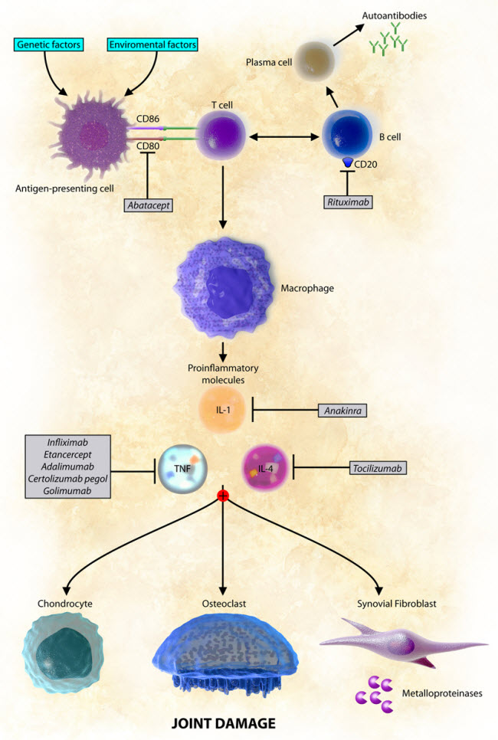
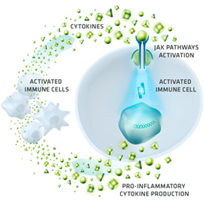
Summary of Biologicals for Tx of RA
Tofacitinib

Slide 15
TNF-α inhibitors
Drugs A-E-I-C-G | Adalimumab (Humira) SQ Etanercept (Enbrel) SQ Infliximab (Remicade) IV Golimumab SQ Certolizumab SQ
MOA | TNF α is a pro inflammatory cytokine Drug neutralizes it
Adverse effects | Immune Suppression Myelosuppression Infection: Reactivation of TB (Pulmonary problems) -> get TB anergy panel Fungal infection (Histoplasmosis, coccidiomycosis) Demyelination of CNS and heart
Notes:
Adalimumab (Humira) AEI - HER
Etanercept (Enbrel)
Infliximab (Remicade)
Ignore dosing

Slide 16
DMARD: Disease-Modifying Antirheumatic Drug
 | Hydroxychloroquine (Plaquenil)
Use | Mild presentations (also for lupus and malaria)
MOA | Inhibit macrophages and B cell function Decrease IL-1 secretion (a type of cytokine)
Dosing | 200 mg PO BID
Time to effect | 2 – 6 months
Adverse effects | Vision Changes (rare) → eye exam q year
Notes:
Know dosing

Slide 17
DMARD: Disease-Modifying Antirheumatic Drug
Gold
Use | Reserved for active RA
MOA | Inhibit macrophage of neutrophils
Dosing | IM
Time to effect | 3 – 6 months
Adverse effects | Rash Stomatitis (mouth) Myelosuppression Thrombocytopenia
Cyclosporine
MOA | Calcineurin inhibitor Prevent activation of T-cells
Dosing | 3 mg/kg/day in 2 divided doses
Time to effect | 3 – 6 months

Slide 18
DMARD: Disease-Modifying Antirheumatic Drug
Azathioprine
MOA | Inhibit lymphocyte proliferation
Dosing | 50 – 150 mg PO daily
Time to effect | 2 – 3 months
Adverse effects | Myelosuppression Hepatic (LFT)
Penicillamine
Use | Unpopular due to Adverse Effects
MOA | Inhibit T cell proliferation by complexing with CU++
Dosing | 250 – 750 mg PO daily
Time to effect | Up to 6 months
Adverse effects | Rash Stomatitis (mouth), dysgeusia Myelosuppression

Slide 19
Drugs: Phase 3 Tx
Rituximab
Abatacept
Tocilizumab
Tofacitinib (Xeljanz)

Slide 20
Phase 3 Tx biologicals (look at algorithm)
Rituximab
MOA | Anti-CD20 monoclonal antibody present on all B cells
Dose (premedicate) | methylprednisolone IV to prevent infusion toxicity + Rituximab 1000 mg IV on week 0, 2
Adverse effects: PML | Progressive Multifocal Leukoencephalopathy is an opportunistic viral infection that demyelinates the brain and within 4 months can lead to death. No treatment.
Abatacept
MOA | Co-Stimulator Blocker: Decrease cytokine release from macrophages Decrease B cell activation Blocks earliest activation of T cells
Dose | 500 – 1000 mg IV on week 0, 2 then monthly
Adverse effects | infections

Slide 21
Phase 3 Tx biologicals (look at algorithm)
Tocilizumab (Actemra)
MOA | IL-6 antagonist
Initial Dose | 4 mg/kg IV over 4 hours q month
Max | 800 mg per infusion
Infusion Rxns | Liver toxicities and cytopenias
Tofacitinib (Xeljanz)
MOA | Janus Kinase (JAK) inhibitor
Dose | PO Dose modifications for Cytopenia, Renal and Hepatic

